Slide 1
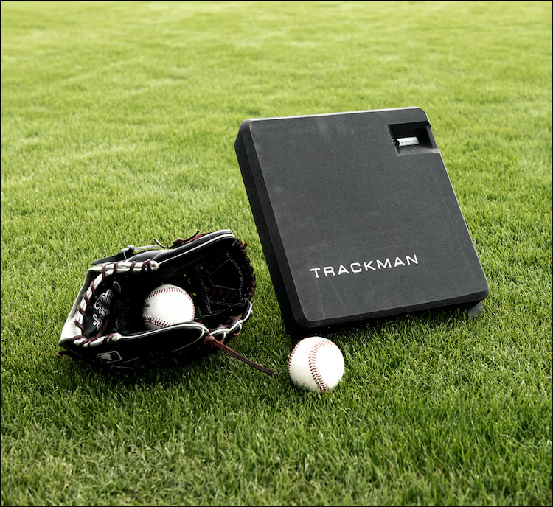
Trackman Baseball
Goal: finding meaningful insights from data files and create visualizations/report for coach
By: Qifang Weng
Notes:
BACKGROUND
Was Formally introduced to one of the coach in LIU post Baseball team, they purchased the 20,000 dollar trackman system in 2023 Fall semester to provide data analysis and data collection to further improve the teams or players’ performances.

Slide 2
What is Trackman?
A specialized tracking system
Limitations on accuracy, player tagged columns
Pitch Tracking
Basic Metric measurements
Hitting Analysis
Data regarding the Batter
Notes:
Pitch Tracking: The system can track the trajectory and various metrics of pitched baseballs, such as pitch velocity, spin rate, and movement.
Hitting Analysis: TrackMan can analyze bat speed, exit velocity, launch angle, and other parameters related to a player's hitting performance.
Trackman used by all professional teams in the United States and Japan, plus nearly all professional teams in Korea, Taiwan, and Latin America. As a trusted partner, Trackman provides the largest and most influential digital baseball scouting platform in the world.

Slide 3
Data Accessing/Gathering
FileZilla application
File Transfer application
File formats in Server
Excel and csv files
Type of files
Batting Practice
Scrimmage games
Combined all scrimmage games in Fall 2023
Notes:
FileZilla is: A File Transfer Protocol (SFTP). It allows users to transfer files between their local computer and a remote server.
To get data files on local devices
Batting Practice files are highly going to skew the data, so we exclude those type of files
Scrimmage Games: refers to a practice game or a simulated game situation and apply them in a competitive setting. It is commonly used during training sessions, offseason workouts, and even before the start of a regular baseball season.

Slide 4
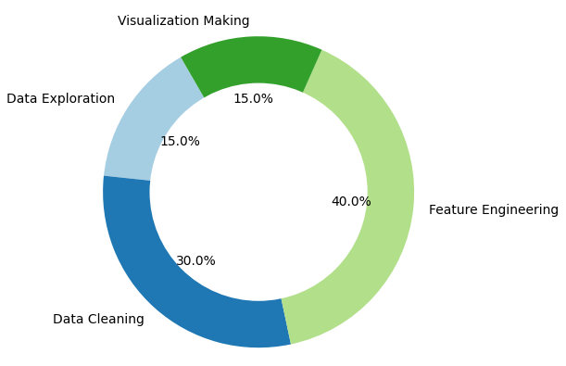
Overall time occupation
Data Exploration:
15%
Data Cleaning
40%
Feature Engineering
30%
Visualization making
15%
Notes:
This is a donut chart of overall time occupation

Slide 5
Data exploratory
Data Structures:
Labeled Columns and features
Consistent values, no abnormal structures detected
Contains null value or blanks
167 different Features
Some column are tagged by pitcher players
Features/columns decide to use are:
'Pitcher','Batter','TaggedPitchType'
'RelSpeed','TaggedHitType','ExitSpeed','PitchCall'
Notes:
Data-Structures:
The data structure in TrackMan Baseball likely involves labeled columns representing various pitching and hitting metrics, with machine pickups generating numerical values or blanks (NaN) for each labeled attribute.
167 different features, this is the first semester they use the system, future will generate more data
No abnormal structures detected.
Some column are tagged by pitcher players

Slide 6
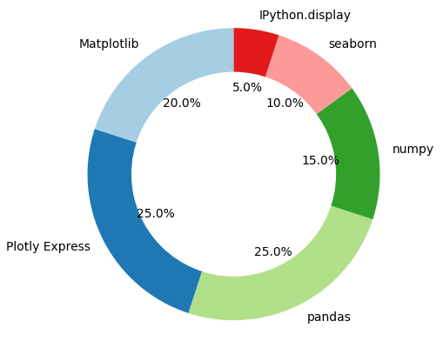
The python libraries used
Libraries :
pandas
Numpy
seaborn
plotly express
matplotlib.pyplot
IPython.display
Notes:
The libraries used include:
pandas for data manipulation
numpy for numerical operations
seaborn for statistical visualization
plotly express for interactive visualization
matplotlib.pyplot for plotting
and IPython.display for displaying HTML content
In my opinion, my estimated occupation on libraries

Slide 7
Data cleaning
Pandas:
Filtering data using different methods and functions
Majority data missing are in column ‘ExitSpeed’
No abnormal structures among columns
Can apply regular expression to check
Notes:
Filtering the data using different methods and functions from pandas library very good at
Data missing are in column ‘ExitSpeed’, because there are various scenarios that there can be no ExitSpeed, so it is a very good idea to not drop the NA values
let's determine a situation when batter swings but missed, it has to be No ‘exitspeed’ & ‘PitchCall’ is strikeCalled

Slide 8
Feature engineering
Design Basis report stats/visualization less
Stats report (e.g) min,max,mean stat values
Create binary columns
Dataset does not have hit or miss column
To assist on making further visual percentages
Correlation may not be meaningful, mostly categorical
Notes:
In order to proceed to data visual, we first will have to organize and putting values in calculation or provide criteria
Additionally, in the absence of a predefined 'hit' or 'miss' column, we've strategically created binary columns.
Column pitch call and tagged pitch type and tagged hit type provides crucial info to determine if the batter swing but missed

Slide 9
Visualization making
Plots
Plotly Boxplot on each batter’s exit speed by tagged pitch type
Ploty HTML plots: Missing counts by tagged pitch type
Further findings:
Plotly plot Overall Missing percentage and hitting percentage/exit speed by tagged pitch type
Notes:
Here I briefly explain some of the charts/ graphs created in the project

Slide 10
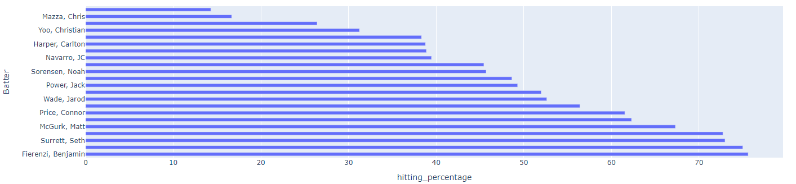
Batter hitting percentages
Notes:
This is a plot shows the percentages on each batter hitting,

Slide 11
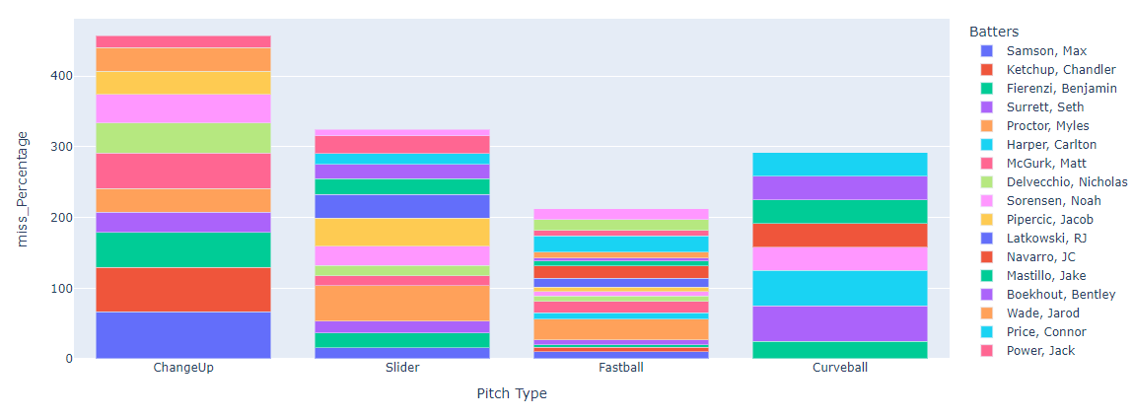
Miss Percentages by Pitch Type and Batter
Notes:
This is a plotly barchart, can be download From github files
: can displays the percentages of the each batter
when double click on the Batters legend., The percentages will be 1 player stat only, not stacked bars
Interactive plots

Slide 12
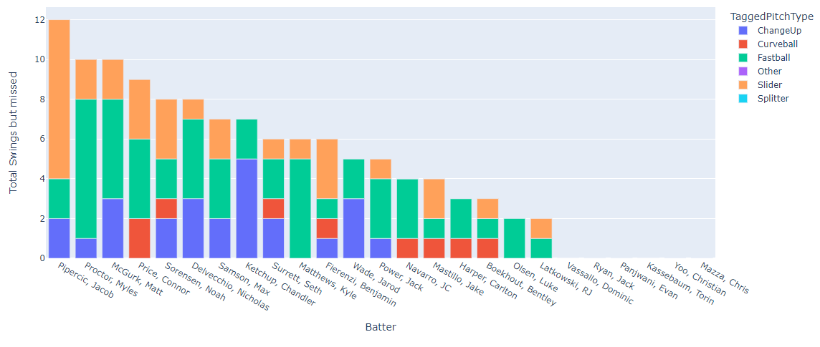
Swing_but_missed, Interactive via TaggedPitchType
Notes:
This interactive plot can filter type of pitch and see the amount of each batter swing but missed counts.

Slide 13
Data files and jupyter notebooks/ppt
Link to github :

